Slide 1
معرفی خصوصیات سیستم های چند رسانه ای
اقتباس از درس سیستم‌های چندرسانه‌ای اقای Prabhakaran دراستنفورد

Slide 2
مشخصات سیستم‌های چندرسانه‌ای
Large sizes:
  Influences storage and retrieval requirements of media objects.
  Distributed multimedia databases: communication requirements also depend on the sizes of the objects.
Real-time nature:
  Along with sizes of the objects, it influence the storage and communication requirements.
Raw/uninterpreted nature of information:
  Contents of the media objects (e.g., audio, image, and video) are binary in nature.
  Multimedia databases have to derive and store interpretations about the contents of these objects.

Slide 3
انواع سیستم‌های چندرسانه‌ای
Orchestrated Multimedia:
  Capture and/or generation of information done by retrieving stored objects.
  Stored multimedia lecture presentations, on-demand servers, and other multimedia database applications fall under this category.
Live Multimedia:
  Information generated from devices such as video camera, microphone or keyboard.
  Multimedia teleconferencing and panel discussion applications fall under this category.
  Participants communicate among themselves by exchanging multimedia information generated from video camera or microphone.

Slide 4
انواع اطلاعات چندرسانه‌ای
Discrete (or Time independent) Media:
  E.g., Text, graphics and images, have no real-time demands.
  Termed discrete media.
Continuous (or Time dependent) media:
  Information becomes available at different time intervals.
  Time intervals can be periodic or aperiodic depending on the nature of the media.
  Audio and video are examples of periodic, continuous media.

Slide 5
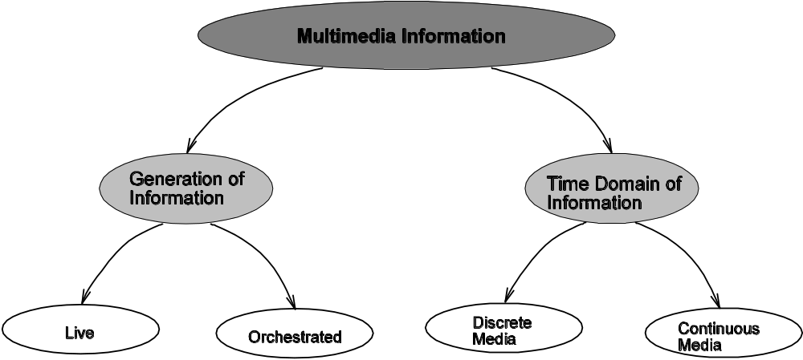
یک دسته‌بندی کلی

Slide 6
سیستم‌های ترکیبی
Orchestrated and live multimedia applications can be composed of both discrete and continuous media.
Live multimedia presentations:
  Images generated using OCR cameras fall under the discrete media category
  Data from video camera and microphone fall under the continuous media category.
  Temporal relationships of the objects in a media are implied.
  Related to the sampling rate used for the media.
    Video, it is 30 frames/second in the United States and 25 frames/second in the Europe.
    Audio, the rate varies from 16 Kbps to 1.4 Mbps.

Slide 7
سیستم‌های ترکیبی
Orchestrated multimedia applications can also be composed of both discrete and continuous media.
Orchestrated multimedia presentations:
  Main Difference: temporal relationships for various media objects have to be explicitly formulated and stored.
  Relationships describe the following:
    When an object should be presented
    How long it should be presented
    How is an object presentation related to those of others (e.g., audio object might have to be presented along with the corresponding video).

Slide 8
کاربرد پایگاه داده MM
Multimedia Mail
Multimedia Shopping Guide
Video Games

Slide 9
دسترسی به MM-DB
Consider a video-on-demand (VoD) database management system with a repository of large number of movies.
Clients can query the server regarding the available movies.
Example VoD server’s response
  A short video clip of the movie
  An audio clip associated with the video clip
  Two important still images taken from the movie
  Text, giving the details such as the director, actors, actresses and other special features of the movie

Slide 10
Query انواع
Query 1: What are the available movies with computerized animation cartoons?
Query 2: Show the details of the movie where a cartoon character speaks this sentence. This sentence is an audio clip saying: “..”
Query 3: Show the movie clip where the following video clip occurs: the cartoon character Woody sends its Green Army men on a recon mission to monitor the gifts situation on its owner's birthday.
Query 4: Show the details of the movie where this still image appears as part of the movie. This image describes the scene where the cartoon character Jessica Rabbit is thrown from the animated cab.
Query 5: Show the movie where Tom Hanks is stuck in an airport.

Slide 11
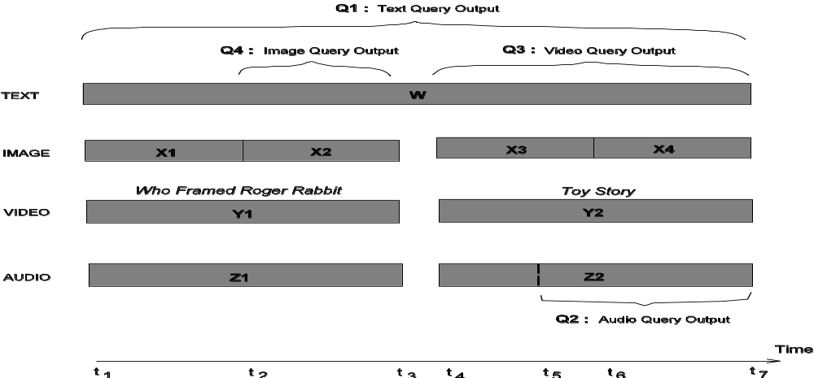
Query انواع

Slide 12
مشخصات محتوی MM
Text Data:
  Often represented as strings.
  Often includes structural information: title, author(s), authors' affiliations, abstract, sections, subsections, and paragraphs.
  A language environment needed to reflect the structural composition of the text data.
  Standard Generalized Markup Language (SGML) is a document representation language defined by the International Standards Organization (ISO).
  Another: Hypermedia/Time-based Structuring Language (HyTime), has also been defined to include support for hypermedia documents (hypertext with multimedia objects)
    With links and support for inclusion of multimedia objects in a text document specification.
  SGML together with HyTime can be used for developing multimedia documents.
  Synchronized Multimedia Integration Language (SMIL): a newer standard from World-wide Web Consortium (W3C)

Slide 13
مشخصات محتوی MM
Audio Data:
  Has an inherent time dependency associated with it.
  Uniform timescales for meaningful interpretation.
  Audio has to be digitized before it can be processed.
  Size of digitized audio depends on the technique used, which in turn depends on the desired audio quality.
  E.g., a normal voice quality digitization is done at 8 KHz with 8 bits per sample, and hence it produces 64 Kb/s of data. → Used in Voice Over IP (VoIP).
  CD quality digitization is carried out at 44.1 KHz sampling rate with 16 bits per sample and hence produces 1.4 Mb/s.
  Digitized audio can be effectively compressed to reduce storage requirements.

Slide 14
مشخصات محتوی MM
Image Data :
  Represents digitized drawings, paintings, or photographs.
  Size of a digitized image depends on the required quality.
  Color images and photographs require more storage space.
  Typically, a color image or a photograph needs the RGB (Red, Green and Blue) components of each pixel to be stored.
  Depending on the color scale chosen, one might need 8 bits per color component implying 24 bits per pixel.
  → for a 1024 * 1024 pixel image, a storage space of 24 Mbits is needed.
  Compression schemes used to reduce the volume of data that needs to be stored.
  Most compression schemes employ algorithms that exploits the redundancy in the image content.
  Different compression algorithms as well as storage representations can be employed and this results in different formats of the digitized images and photographs.
  Joint Photographers Experts Group (JPEG): standardized by ISO.
  Other popular formats: Graphic Interchange Format (GIF) and Tag Image Format (TIFF).

Slide 15
مشخصات محتوی MM
Graphics Data :
  Represents the concepts that allow generation of drawings and other images based on formal descriptions, programs, or data structures.
  International standards have been specified for graphics systems to serve as a basis for industrial and scientific applications.

Slide 16
مشخصات محتوی MM
Video Data :
  Represents the time dependent sequencing of digitized pictures or images → video frames.
  Number of video frames per second depends on the standard that is employed.
    NTSC (National Television Systems Committee) - 30 frames/second while
    PAL (Phase Alternation Line) - 25 frames/second.
  Pixel size of a frame depends on the desired quality.
  Normal NTSC frames are 512 * 480 pixels in size.
  HDTV (High Definition Television) - employ 1024 * 1024 pixels.
  Number of bits needed per pixel reflects the quality of digitized video frame.
  Compression schemes need to be employed to reduce the volume of data to be stored.
  Motion Pictures Encoding Group (MPEG) – ISO Standard.
  MPEG standard series includes specs for storing audio along with compressed video.

Slide 17
مشخصات محتوی MM
Generated Data :
  Represents computer generated presentations such as animation and music.
  Difference - data is generated based on a standard representation.
  E.g., Musical Instrument Digital Interface (MIDI) defines the format for storing and generating music using computers.

Slide 18
دسترسی چندبعدی به محتوی MM
1-Dimensional Objects:
  Text and speech objects
  Reason - text and audio are to be accessed in a contiguous manner
2-dimensional Objects:
  E.g., Image objects - Access to image data can be done with reference to the spatial locations of objects.
  E.g., a query can search for an object that is to the right of or below a specified object.
3-dimensional Objects:
  E.g., Video objects – both spatial as well as temporal characteristics
  Access to video can be done by describing the temporal as well as the spatial content.
  E.g., a query can ask for a movie to be shown from 10 minutes after its start.
4-dimensional Objects:
  3-D + Time Dimension
  E.g., 3D heart-beat visualization – 3D heart image expanding and contracting over time.

Slide 19
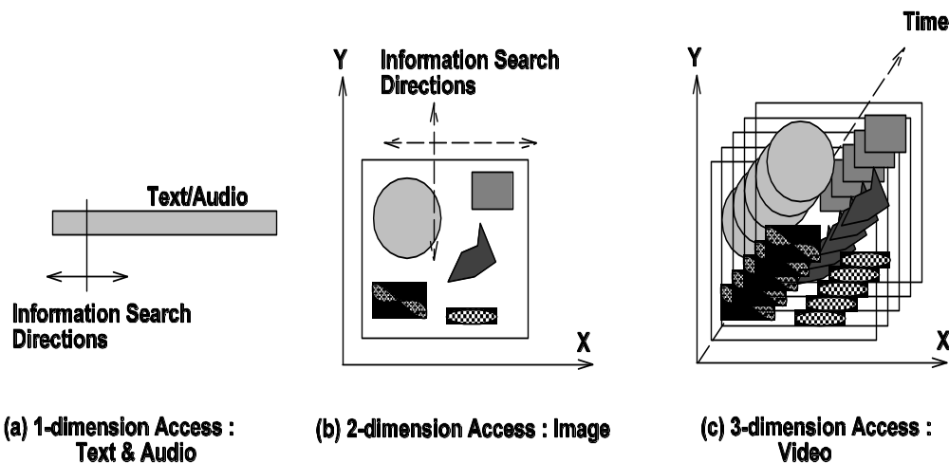
دسترسی چندبعدی به محتوی MM

Slide 20
دسترسی چندبعدی به محتوی MM
Access dimension of an object, in a way, describes the complexity in the process of searching.
1-dimensional objects (text and audio) - the access is limited to the keywords (or other related details) that appears as part of text or speech.
Images - access is done by specifying the contents as well as their spatial organization.
Video – access is based on contents, spatial as well as temporal organization.

Slide 21
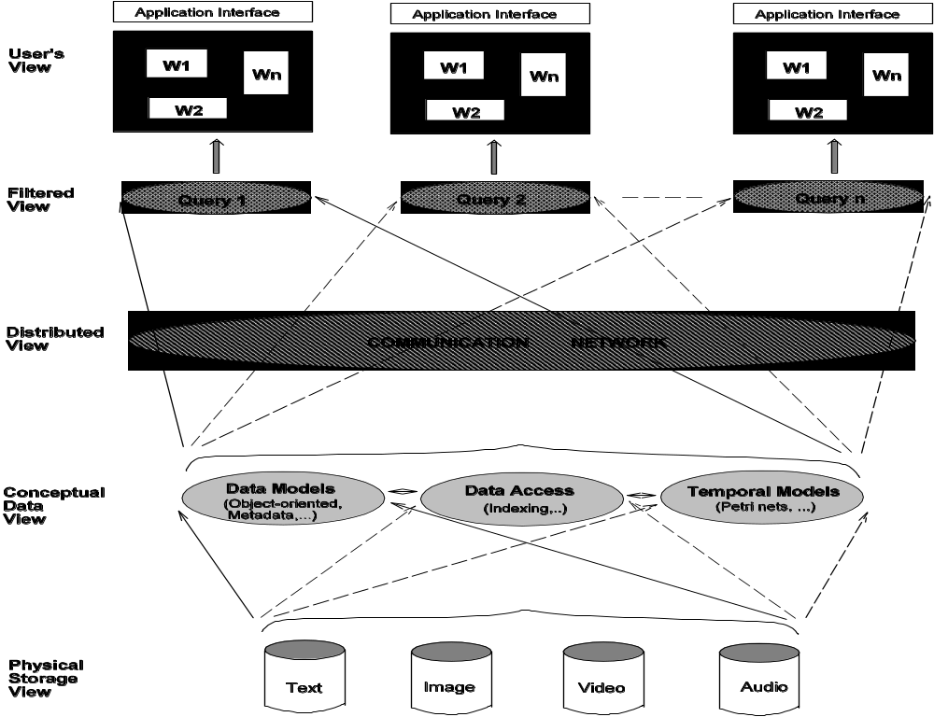
اجزا و لایه‌ها در دسترسی MM

Slide 22
اجزا و لایه‌ها در دسترسی MM
Physical Storage View:
  how multimedia objects are stored in a file system.
  Since multimedia objects are typically huge, different techniques needed for their storage as well as retrieval.
Conceptual Data View:
  Describes the interpretations created from physical storage representation of media objects.
    Needed because most object are just Binary Large Objects (BLOBs).
  Also deals with the issue of providing fast access to stored data by means of index mechanisms.
Distributed View:
  MM objects might be stored in different systems.
  Systems and users might access stored data over computer networks.

Slide 23
اجزا و لایه‌ها در دسترسی MM
Filtered View:
  Users can query multimedia databases in different ways, depending on the type of information needed.
  Queries provide a filtered view of the multimedia databases retrieving only the required objects.
User’s View:
  Objects retrieved from the database(s) have to be appropriately presented.
  Though these views are true for a traditional database management system, diverse characteristics of media objects introduce many interesting issues.
B. Prabhakaran

Slide 24
حافظه فیزیکی MM
Main issues - object sizes and time (temporal) requirements.
  Sizes of objects influences the storage capacity requirements
  Temporal requirements - the retrieval bandwidth (in terms of bits per second) requirements.
  The disk bandwidth requirements
Disk bandwidth for discrete media (e.g., text, images)
  Depends on multimedia database applications.
  → These media do not have any inherent temporal requirements.
  Bandwidth requirements of discrete media might depend on the number of images or pages of text, that needs to be presented within a specified interval of time.

Slide 25
حافظه فیزیکی MM
Continuous media (e.g., video, audio) have inherent temporal requirements, e.g., 30 frames/second for NTSC video.
→ an uncompressed 5 minutes video clip object will require 300 times its storage space for 1 second.
E.g., a 5 minutes uncompressed HDTV clip requires 33 GBytes.
Disk bandwidth requirements (for storage and retrieval) is proportional to their temporal requirements
  Since the temporal characteristics dictate the storage as well as the presentation of the data.
Stored video data might be accessed by multiple users simultaneously.
Hence, these characteristics of video demands new capabilities from the file system and the operating system.

Slide 26
نیازمندی File System
Capabilities for:
  Handling huge files (of the order of Gigabytes)
  Supporting simultaneous access to multiple files by multiple users
  Supporting the required disk bandwidth
Caching strategies should also support the above requirements.
Data might have to be distributed over an array of disks in the local system or even over a computer network.
New access interfaces: e.g., play, fast forward, reverse, etc., apart from the traditional ones such as open, read, write, close and delete.

Slide 27
نیازمندی سیستم عامل
Capabilities for handling real-time or quasi real-time characteristics.
Operating system should addresses:
  Scheduling of application processes
  Communication between an application process and the operating system kernel
Scheduling should allow for the real-time characteristics of multimedia applications – reservation of resources might be needed.
→ Admission control needed before creating new processes.
Mixture of processes with and without real-time requirements → need for more than just one scheduling policy.
Reduced overhead in the communication between application processes and the operating system kernel.
→ Directly affects the performance of applications.

Slide 28
مدل مفهومی دیتایMM
Conceptual data view of raw multimedia data helps in building a set of abstraction or features.
For fast accesses, indexing mechanisms are needed to sort the data according to the features that are modeled.
Multimedia database may be composed of multiple media objects whose presentation to the user has to be properly synchronized – e.g., video along with audio.
Synchronization characteristics → temporal models.
Conceptual view components :
  Metadata
  Indexing mechanisms
  Temporal models
  Spatial models
  Data models

Slide 29
متادیتا Metadata
Deals with the content, structures, and semantics of media objects.
From the maintenance of multimedia database point of view, automatic or semi-automatic generation of metadata is needed.
E.g., video metadata: techniques needed to identify camera shots, characters in a shot, background of a shot, etc.
Human interaction might be needed to annotate the sequences based on their semantic content, thereby rendering the techniques semi-automatic.
For image data, techniques should extract and describe the features of interest.
Recognition techniques might be needed for identifying keywords in audio and text data.

Slide 30
روش‌های اندیس(علامت)‌گذاری
Multimedia databases need indexing mechanisms to provide fast access.
Traditional databases techniques do not serve this purpose fully, since new object types have to be dealt with.
Indexing mechanisms should be able to handle different features of objects such as color or texture.

Slide 31
رابطه زمانی در محتوی MM
Describe the time and duration of presentation of each media object as well as their temporal relationships to other media objects.
Temporal requirements of objects need to be specified and stored along with the database.
B. Prabhakaran

Slide 32
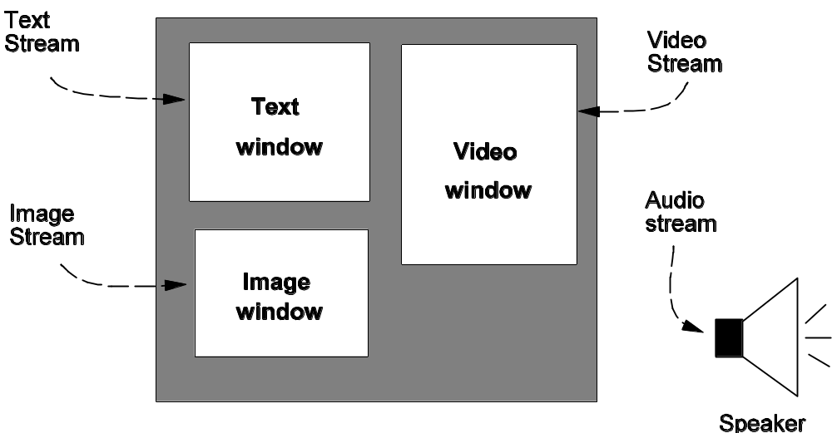
رابطه مکانی در محتوی MM
Represents the way media objects are presented, by specifying the layout of windows on a monitor.
B. Prabhakaran

Slide 33
توزیع‌شدگی در سیستم MM
Multimedia data can be distributed over computer networks.
Huge sizes of media objects require large bandwidths or throughput (in terms of bits per second).
Real-time nature of the objects needs guarantees on end-to-end delay and delay jitter.
End-to-end delay specifies the maximum delay that can be suffered by
data during communication.
Delay jitter describes the variations in the end-to-end delay suffered by the data.
Guarantees on end-to-end delay and delay jitter are required for smooth presentation of continuous media objects such as audio and video.
E.g., if video data is not delivered in periodic intervals (within the bounds specified by the delay jitter parameter), users may see an unpleasant, jerky video presentation.

Slide 34
جستجوی محتویMM
Filtered View
Provided by a user's query to get the required information.
Query can be on any of the media that compose a database
User's query can be of the following types:
  Query on the content of media objects
  Query by example (QBE)
  Time indexed queries
  Spatial queries
  Application specific queries

Slide 35
انواع جستجوها
Queries
Content Based Queries:
  Typically metadata queries.
  E.g., Query 1.
Query By Example
  Multimedia database management system has to process the example data and find objects that match the input query object.
  Requirement for similarity can be on different characteristics associated with the media object.
  E.g., similarity matching can be requested on texture, color, spatial locations of objects in the example image, or shapes of the objects in the example image.
  Required similarity matching between the queried object and database objects can be exact or partial.
  In the case of partial matching, we need to know the degree of mismatch that can be allowed.
Time Indexed Queries
  E.g., Show the first car accident 30 minutes after the movie start.
Spatial Queries
  E.g., Show me the image where Saddam Hussein is seen to the left of President Bush.
Application Specific Queries: uses domain-specific terms
  E.g., Show me the video where the tissue evolves into a cancerous one

Slide 36
آنچه کاربر می بیند
User's View
User query interface
Presentation of multimedia data
User interaction during presentation

Slide 37
آنچه کاربر می بیند
User's View
User query interface
  Allow users to query by content, example, time, spatial, or a combination of these possibilities.
  For queries by example, the user query interface has to obtain the example object from appropriate devices (e.g., example image object can be obtained through a scanner or from a stored file).
  Query interface can provide suggestive inputs so as to ease the process of querying.
  In case of partial matching of the resolved queries, the query interface can suggest ways to modify the query to get exact matches.

Slide 38
آنچه کاربر می بیند
User's View
Presentation of multimedia data
  Object presentation tools should be capable of handling different formats.
  Conversion of data from one format to another format before presentation might be needed.
  Associated temporal and spatial constraints have to be “honored”.
User interaction during presentation
  Devices such as microphone and video camera can be used for speech and gesture recognition, apart from keyboard and mouse.
  Simultaneous control of different devices and handling of user inputs is required.
  Input from the user can be of following types :
    Modify the quality of the presentation, e.g., reduction or magnification of the image
    Direct the presentation, e.g., skip, reverse, freeze or restart

Slide 39
خلاصه:
چه چیزی سیستم‌های MM را متمایز می‌کند؟
Sizes of the objects
Real-time nature
Raw or un-interpreted nature of the information.

